Slide 1

Notes for Teachers
This PowerPoint gives primary school children a variety of tasks to do before, during and after a visit to Market Rasen Railway Station’s Heritage Centre. The slides are written to directly address the children.
The PowerPoint is designed to be edited so that you can tailor the content to your students and the tasks you want them to do.
The slides work in conjunction with a PDF that includes all information panels on display in the centre. This PDF can be downloaded from the Learning Resources page of the website:
http://marketrasenstation.com/learning-resources/
Please do not use the content of these slides outside of educational activities relating to the Heritage Centre visit, many images are covered by intellectual property right, so should only be used in school work relating to this project.
If you have any questions or feedback, please email them to holdings@lindumgroup.co.uk

Slide 2
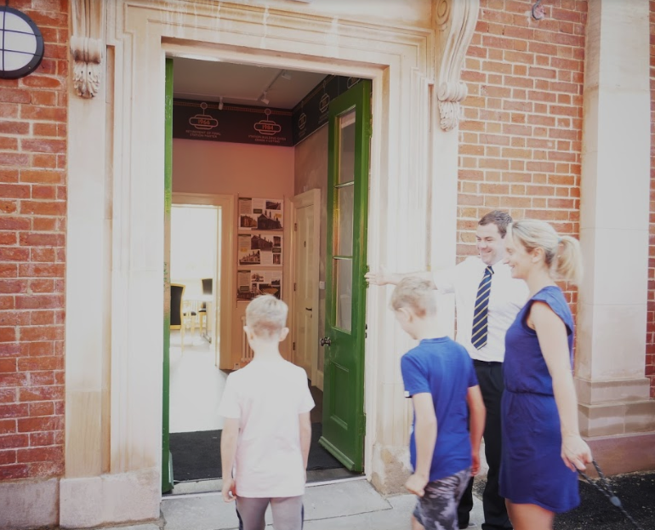

A visit to Market Rasen Railway Station

Slide 3
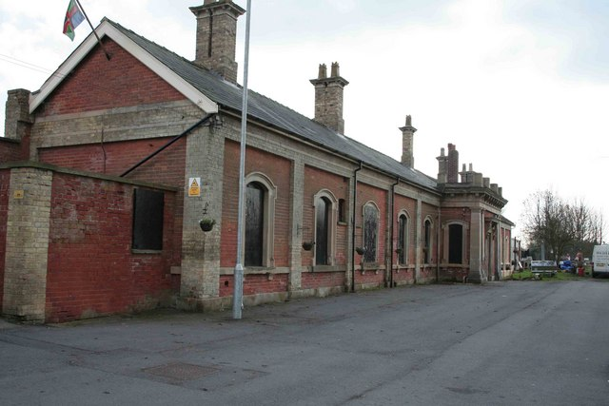
Our Building Before Restoration
When you restore something, you bring it back to how it was before. For the building you are going to visit, the restoration has taken over three years to complete and involved replacing and repairing all sorts of things – floors, ceilings, doors, walls windows, water pipes and electricity cables… to name just a few!
How did our building get into such a bad state? Built in 1848, it was closed in 1995 and became more and more damaged the longer it was left empty and uncared for. Several attempts were made over the years to restore it, but these sadly failed because it takes a lot of money to fix a big, old building like this one.

Slide 4
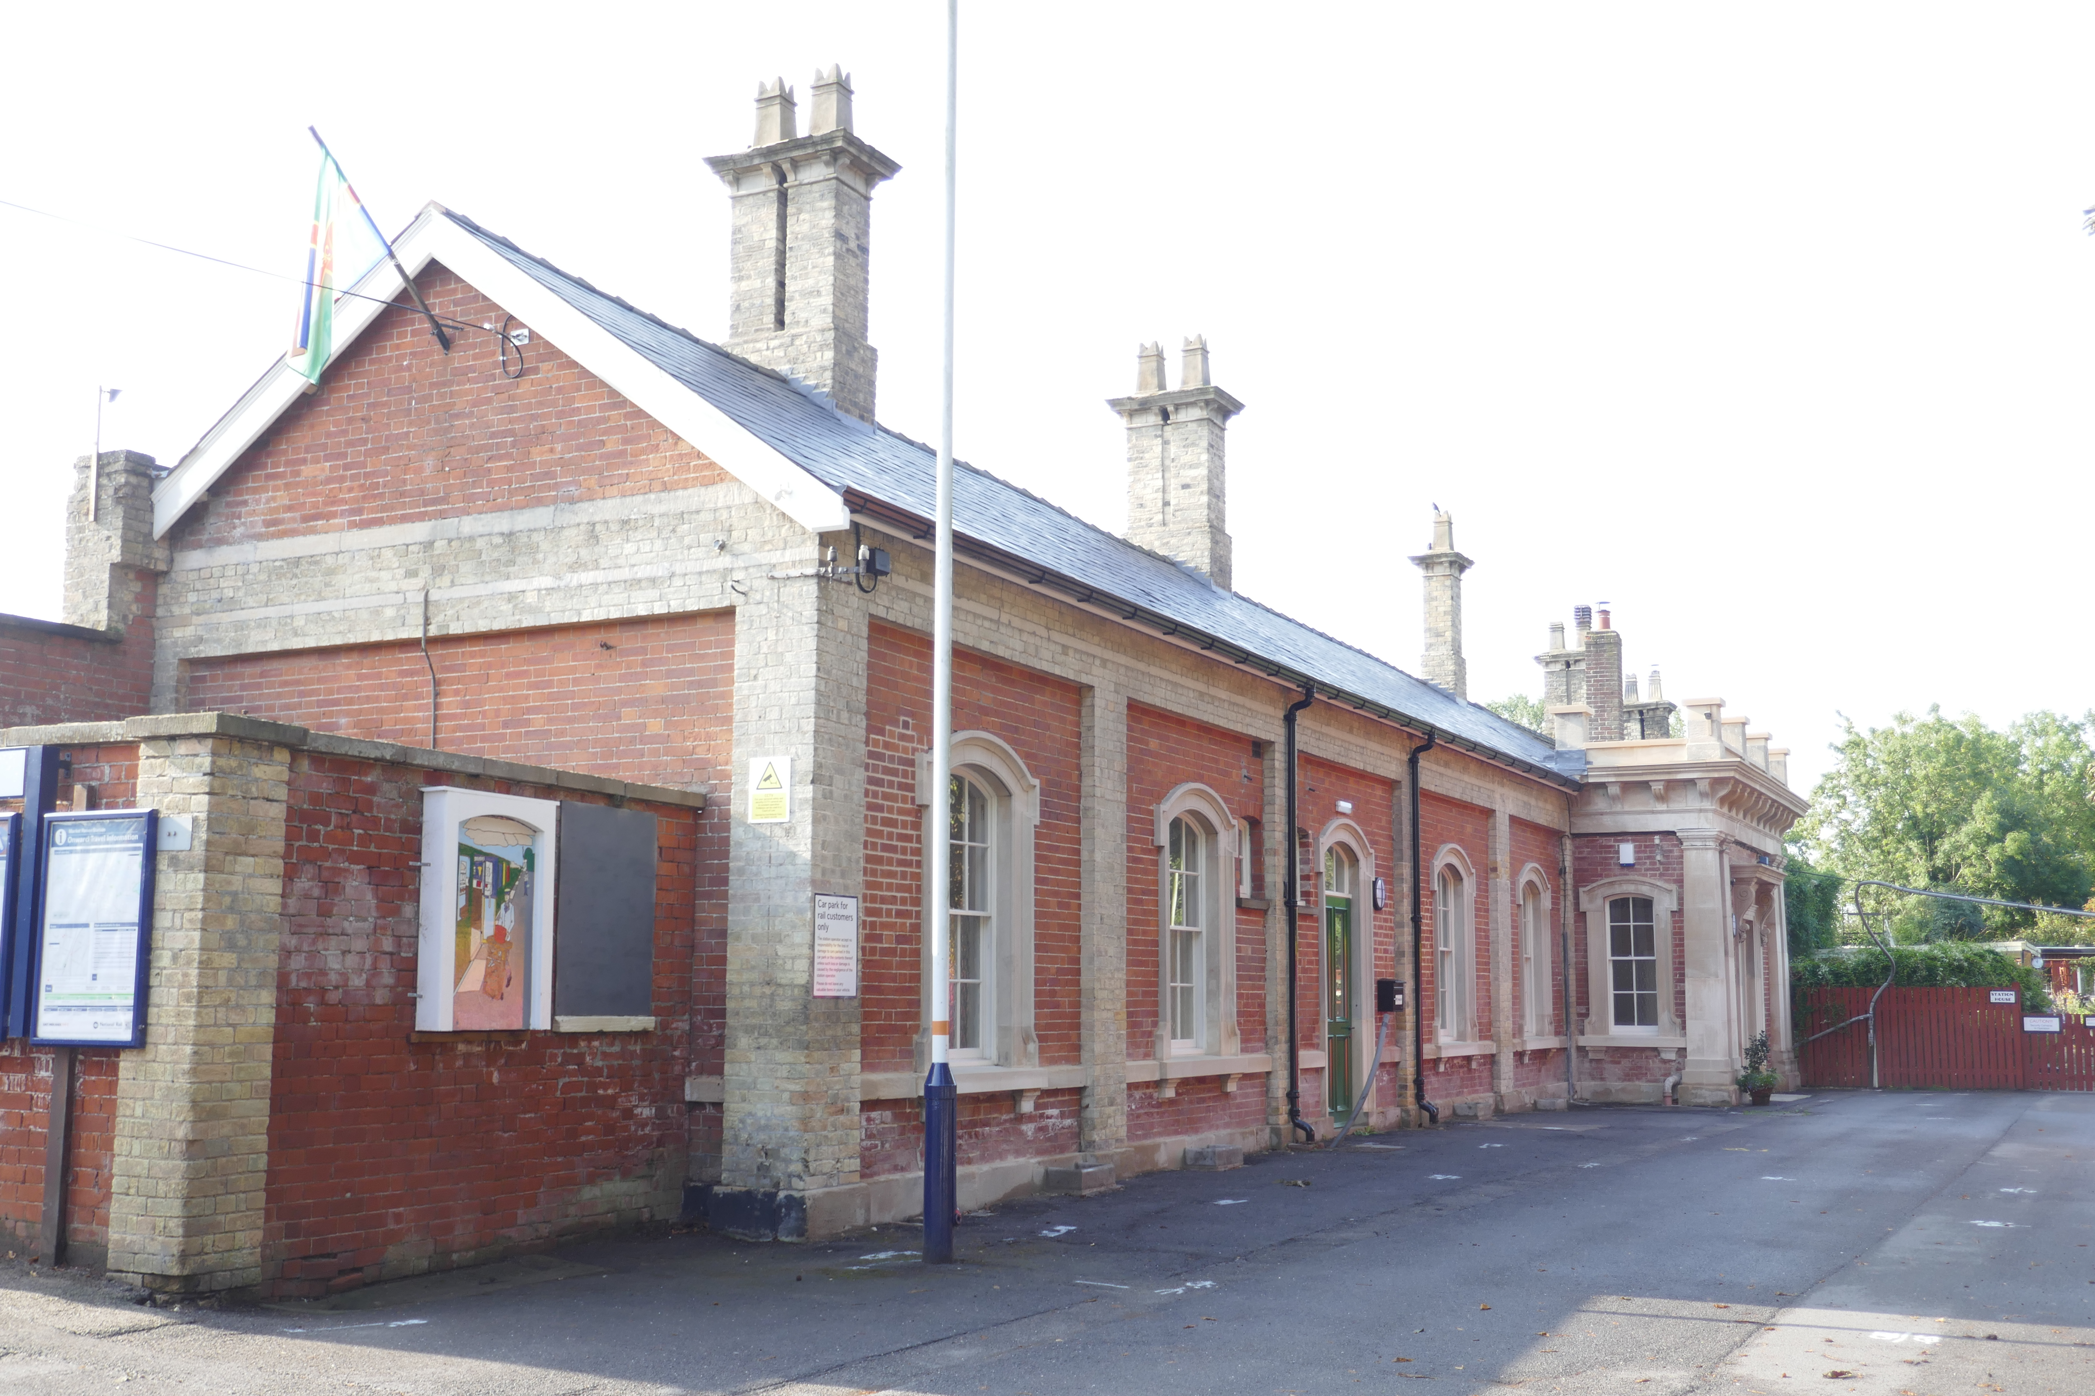

Our Building After Restoration
Finally, in 2014, the building was bought at auction by new owners. They asked the Heritage Lottery Fund if they could help them restore the building by providing much of the money needed, which the Heritage Lottery Fund agreed to do.
If your family buy National Lottery tickets, they are helping projects like this one!
You will see the wonderful results of all this hard work when you visit the building, along with many photos revealing the sorry state of the building and its amazing restoration journey.

Slide 5
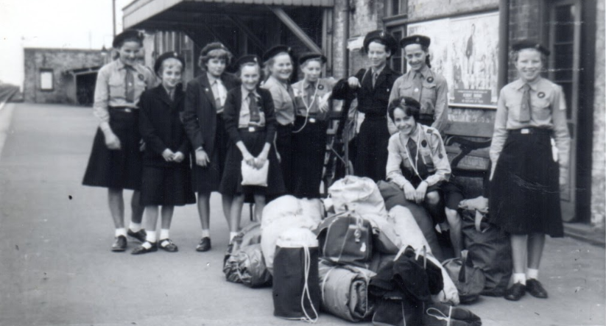
Safety first: you are visiting a working station!

Slide 6
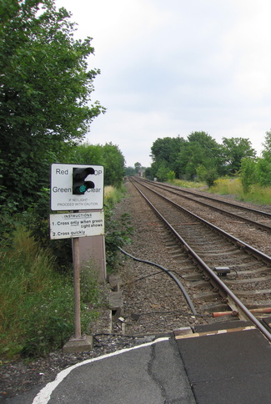
Crossing Railway Lines
Market Rasen is a working railway station, so trains may come and go during your visit. Some trains do not stop at the station and will travel through very quickly.
Just like a road, a railway track can be dangerous and there are rules for crossing a track safely. To visit both platforms at the station, you will need to cross the track.
Before your visit, find out how to cross railway lines safely. Research the different types of crossings you might come across, including the crossing at Market Rasen station. Make sure you know how to stay safe during your visit and whenever you need to cross a railway line.
Useful website:
www.networkrail.co.uk/primary-schools

Slide 7
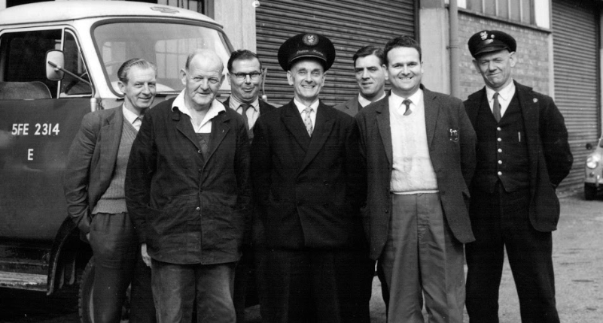
Tasks that involve visiting the Heritage Centre and Platform 1 (avoiding a railway line crossing)

Slide 8
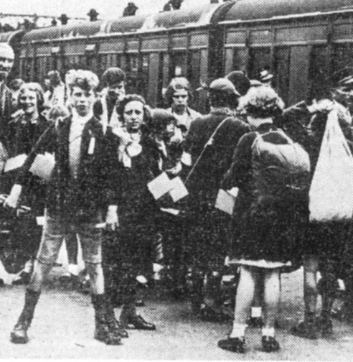
Who are They?
This was a photo taken at Lincoln railway station.
When do you think this photo was taken?
Why are so many children on the platform together, without their parents?
Can you see the children have labels, why do they need them?
Can you see the small boxes they are carrying? Do you know what they are?

Slide 9
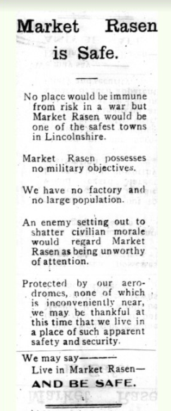
The Evacuees
The children in the photo are evacuees. The photo was taken in World War II. The boxes have gas masks in them, and the labels included their name, address, school and destination.
As part of the war effort, local families offered their homes to children from larger industrial towns that were likely to be bombed. These young evacuees arrived at the station on special trains from Leeds, accompanied by their teachers. The Market Rasen Mail ran an advert saying how safe it was to live here!
Before your visit, find out more about evacuees and what they carried.
During your visit, look for the giant photo of evacuees in the Heritage Centre. Read the panel ‘Wartime at the Station’ and imagine you are an evacuee from Leeds arriving at the station in WWII. Make notes during your visit about what you can see and how you might feel.
After your visit, write a letter home as if you are an evacuee.
Related Panel: Wartime at the Station

Slide 10
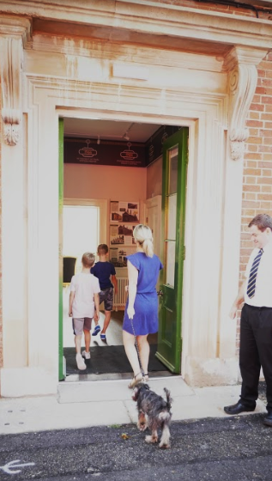
The Timeline
During your visit to the heritage centre, you will see a timeline at the top of the room, which shows the key events that have happened since the building opened.
This timeline is on the next two slides for you to print out.
After your visit, research key events that were happening in the world at the same time as the events at the station. Add these to the timeline print out.
Your finished timeline will show what was happening in the world at the same time as these key changes happened in Market Rasen.

Slide 11
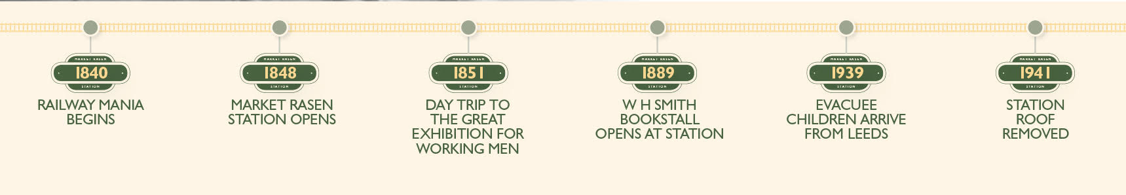

Slide 12


Slide 13

The Lion and Wheel Emblem
During your visit, read the Railway Companies panel and look for logos and emblems around the station.
This is the British Rail emblem used from 1949-1964, which featured on the side of the trains. It was designed by Charles Franklyn.
What can you see? Why do you think Charles Franklyn used a wheel and a lion?
After your visit, design an emblem for your class
What do you want people to think of your class? If your class was an animal, what kind of animal would it be? What words would you add? Could your class have a motto?
Related Panel: Railway Companies

Slide 14
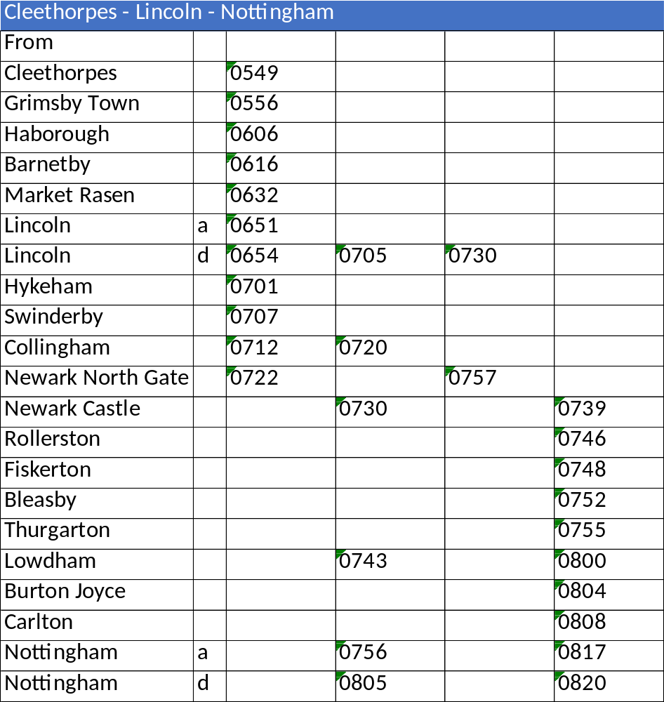
Timetables
Here’s part of the timetable you can see at Market Rasen station
One train on this table stops at Market Rasen, what time does it stop here?
Where did that train start its journey?
When does that train arrive in Newark North Gate?
How long does it take to travel from Market Rasen to Newark North Gate?
See if you can find the full timetable when you visit the station.

Slide 15
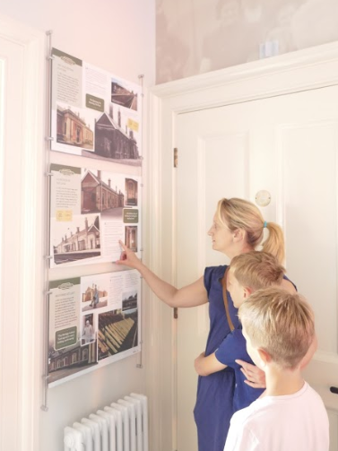
Create a Panel
During your visit look carefully at the information panels in the Heritage Centre. They all have a similar look; what colours, shapes and symbols are repeated in the panels? Why is some text large and some text small?
After your visit, design a new panel for the Heritage Centre, telling everyone about your class visit. Include photographs of your class visit if you can.
Email your work to holdings@lindumgroup.co.uk. Some of the panels will be chosen to display on the website www.marketrasenstation.com
The next slide has a blank panel to get you started!

Slide 16


Slide 17
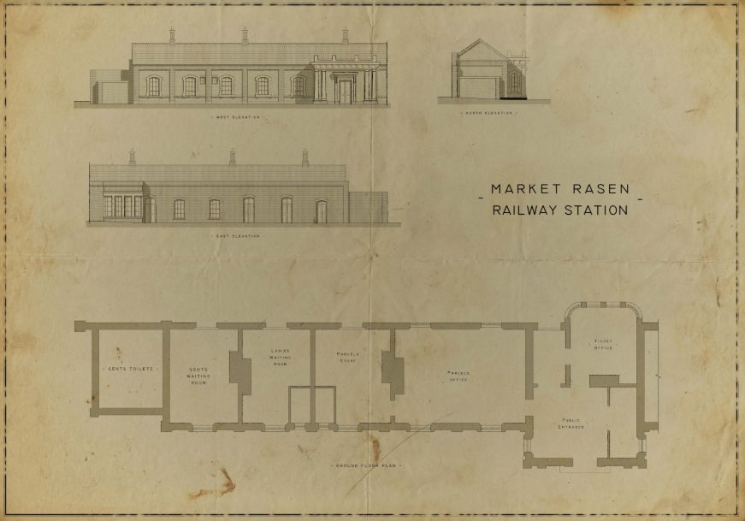
The Plan
The original architect’s drawings for the railway building were lost, so we have recreated how they could have looked (a larger plan is on the next slide).
Count how many doors, windows and fireplaces there are, including the bay windows.
Here’s a price list:
  Doors: £90
  Windows £270
  Station Master’s Bay Window: £600
  Fireplaces: £300
How much would it cost to buy all the doors, windows and fireplaces needed for the railway station building?
Related Panel: A Grand Design

Slide 19
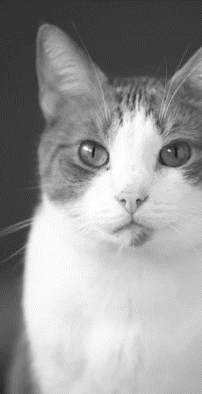
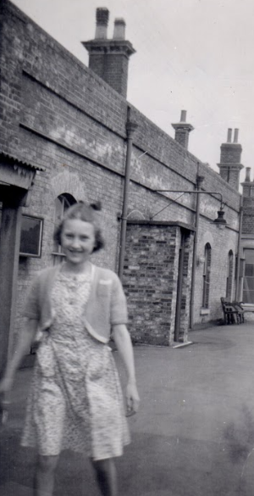
The Station Cat
During your visit, read Eileen’s Story panel and listen to her audio story too. Also, read the panel called “A 1950s Day at the Station”.
Then, imagine you are Eileen Kew’s cat and you are on your morning patrol of the platforms back in the 1950s.
After your visit write a story as the cat. Talk about who you see and what they are doing. Maybe your story can include helping someone, or getting lost in cellar!
Related panels: Eileen's Story and A 1950s Day at the Station

Slide 20
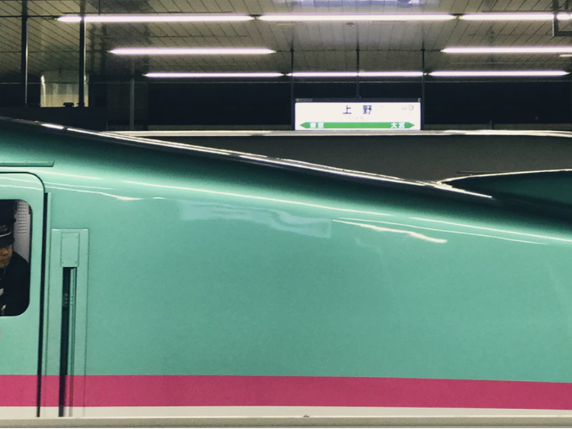
Market Rasen 2048
The Market Rasen line opened in 1848. In 1948 the railways were nationalised with the birth of British Rail, this means they were owned by the government, not individual companies.
After your visit, think about what the station will look like in 2048. Draw a picture to show the railway station in the future
Related Panel: Railway Companies

Slide 21
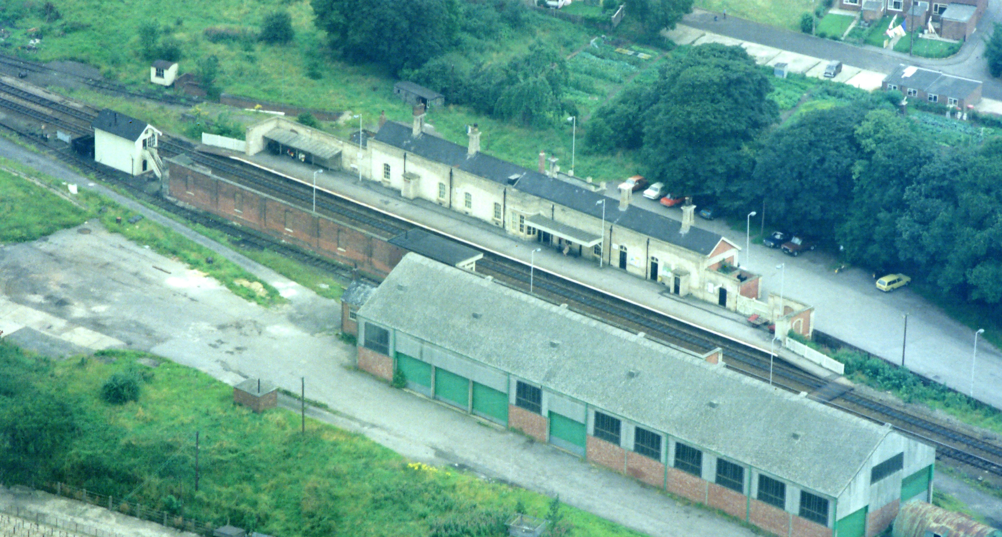
Tasks that involve visiting the Heritage Centre and Platform 2 (including a railway line crossing)

Slide 22
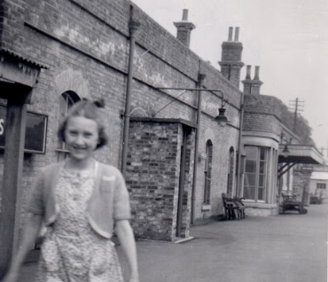
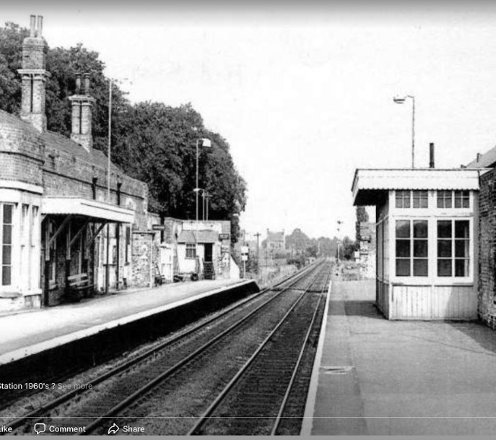
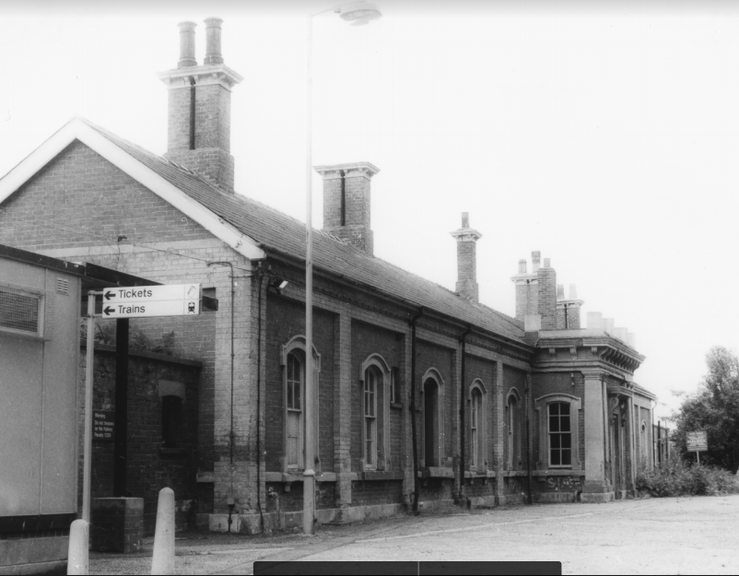
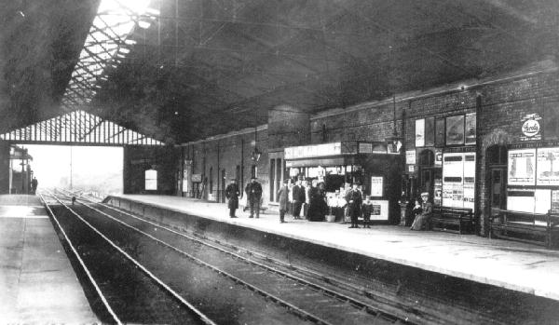
During your visit find the exact place at the station where these photos were taken in the past. Make a note of what’s changed. Find out about the missing station roof in the Heritage Centre

Slide 23
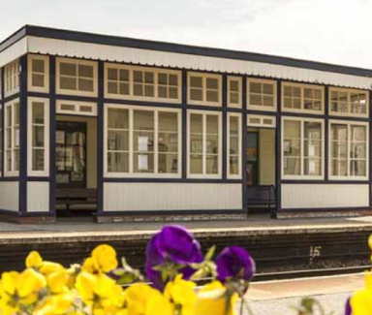
The Waiting Rooms
During your visit, go to the waiting room on Platform 2. Make a tally chart.
Record the number of square windows. Record the number of rectangular windows.
After your visit, calculate:
What percentage of windows are square? What fraction of windows are rectangular?
Related Panel: Waiting Rooms

Slide 24
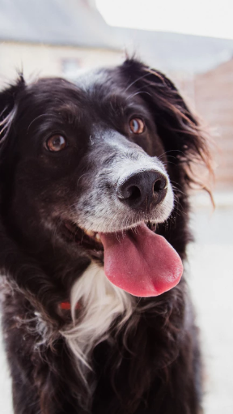
Creeping in to the Waiting Rooms
During your visit read the Waiting Rooms panel and make sure you visit the real-life waiting rooms too.
After your visit, write and perform a short play about people creeping into the waiting rooms in the 1980s to get warm.
Research the 1980s and decide what people would be talking about in the waiting room, such as historical events, TV programs and music. Perhaps you can ask your parents and grandparents about the 1980s too?
End your play with Christopher Smith arriving with his dog to “turf” everyone out.
Related Panel: Waiting Rooms

Slide 25
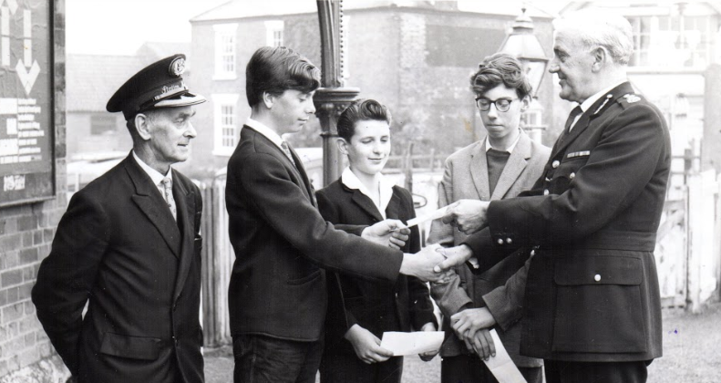
Enjoy your visit and do please tell the people at the Heritage Centre what you did! You can email them on holdings@lindumgroup.co.uk

